Slide 1
Parallelism Between Animal Farm And Russian Revolution
Events Comparison

Slide 2
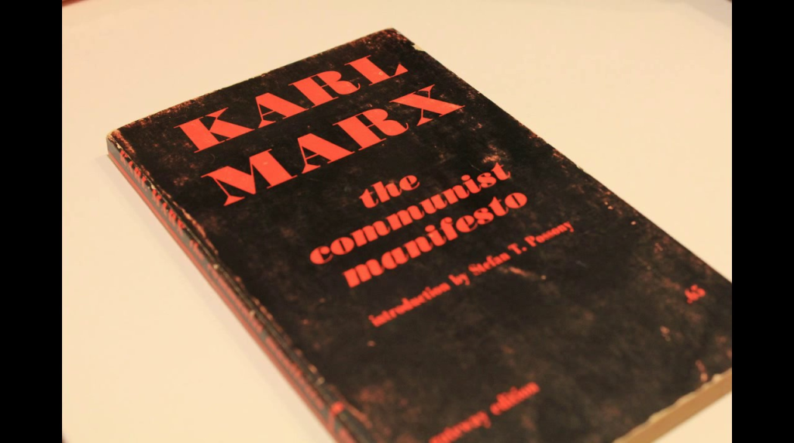
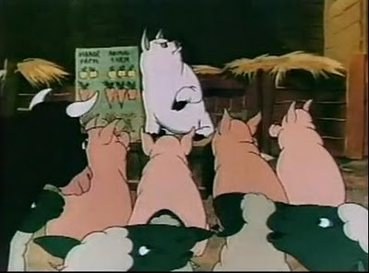
Event one
Old Major Speech
Karl Marx’s Book
In the beginning, Old major told the animals about his dream and idea, Animalism.
This relates to Karl Marx’s book “Communist Manifesto”.

Slide 3
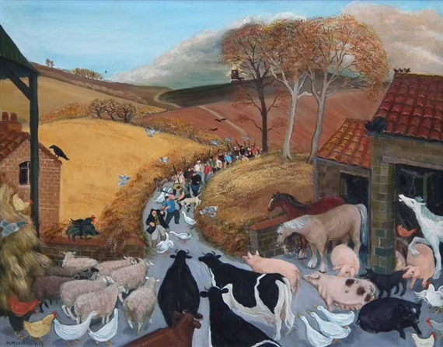
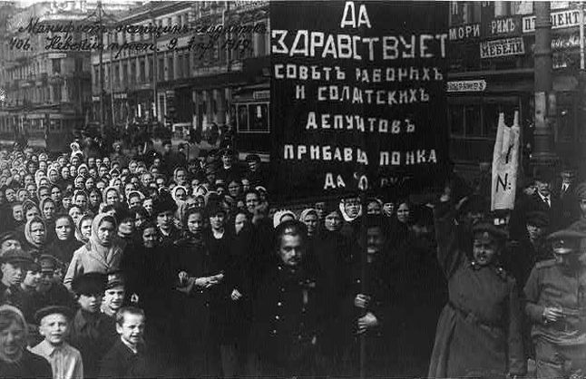
event two
The Battle of the Cowshed
The October Revolution
The animals crowded together, kicked down the fence, went to food supply, and rebelled when they had been left with no food.
In October 1917, the Russian people revolted against Czar Nicholas’s rule.

Slide 4
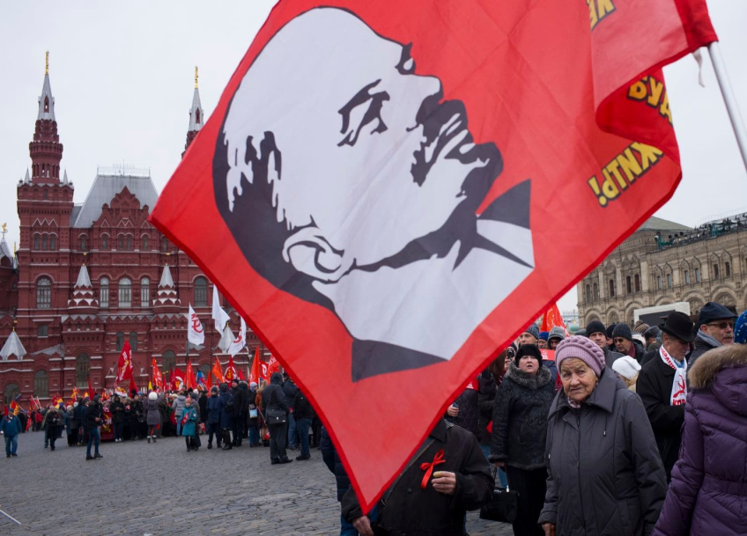
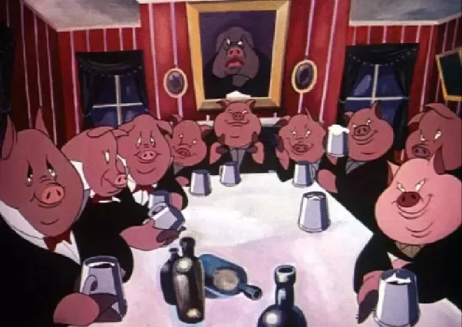
event three
The Pigs in Control
The Bolshevik Takes Over
After the rebellion, pigs revealed that they had been learning in secret and they naturally emerged as in charge.
The Bolshevik’s party emerged as the leaders after the revolution.

Slide 5
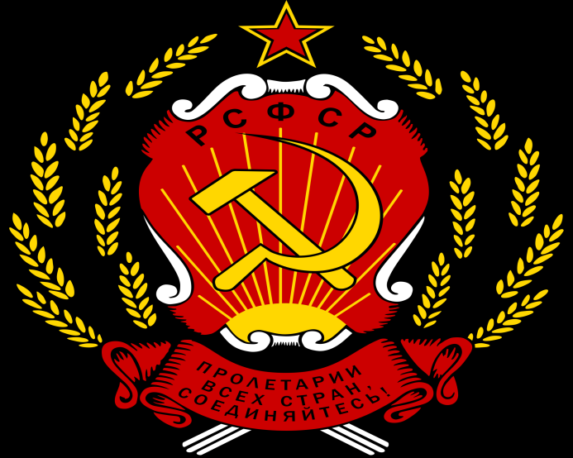
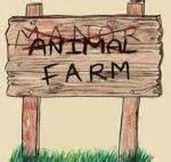
Event four
Animal Farm
Russian Soviet Republic
After the Seven Commandments, Snowball changed the farm’s name to Animal Farm.
After the revolution Russia’s name was changed to Russian Soviet Union.

Slide 6
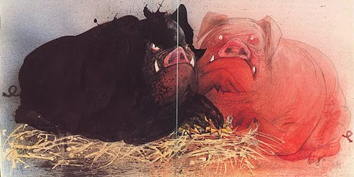
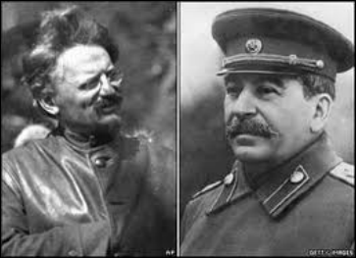
event five
Old Major’s Death
Lenin’s Death
After old major’s death, the race for power was between Snowball and Napoleon.
After Lenin’s death, the struggle for power was between Trotsky and Stalin.

Slide 7
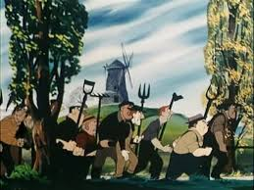
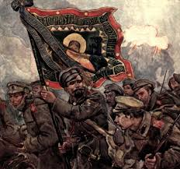
event six
The Battle of the Windmill
White Russian Reattempt
The battle between humans and animals when humans came back for the farm.
The time when the White Russian (ex-Czar Nicholas’s followers), tried to get Russia back.

Slide 8
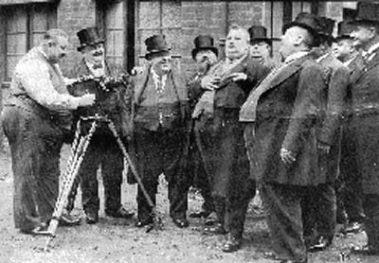
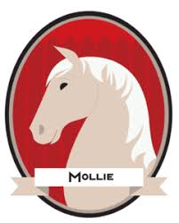
Event seven
Mollies Departure
Russian Wealthy Class’s Escape
Mollie the horse ran away because she wanted her ribbons and sugar cubes, but couldn’t get them now that Jones was gone.
Since the rich were taxed heavily to make it fair for the poor people with no jobs, the wealthy class left Russia.

Slide 9
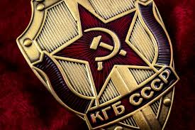
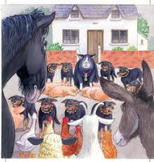
event eight
Napoleon’s Dogs
Stalin’s KGB
Napoleon took Jessie’s pups, and raised them. Once they were grown, they were vicious, blood-thirsty animals.
Joseph Stalin’s formed KGB, who ruthlessly carried out all his commands, no matter how cruel.

Slide 10
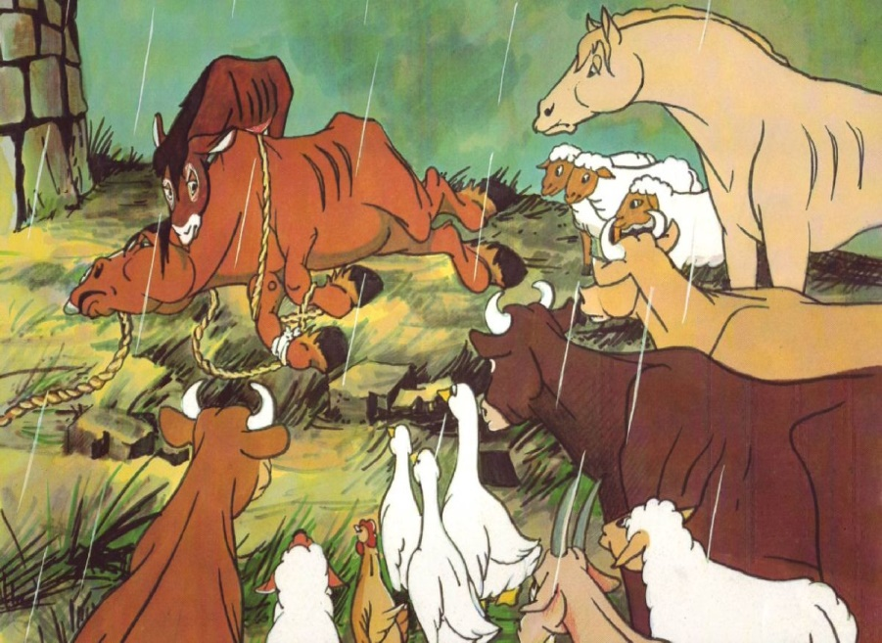
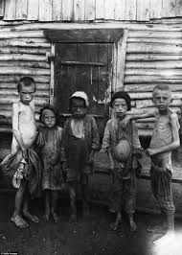
event nine
Food Supplies Shrink
Failure of Five Year Plan
All the animals were starving except the pigs, yet they were told that they were doing better than in Jones’s time.
Stalin five year plan failed because he gave more importance to weapons and industrial power that the people all across Russia were starving.

